Slide 1

Web Development Fundamentals
A beginner's journey through HTML, CSS, and JavaScript

Slide 2
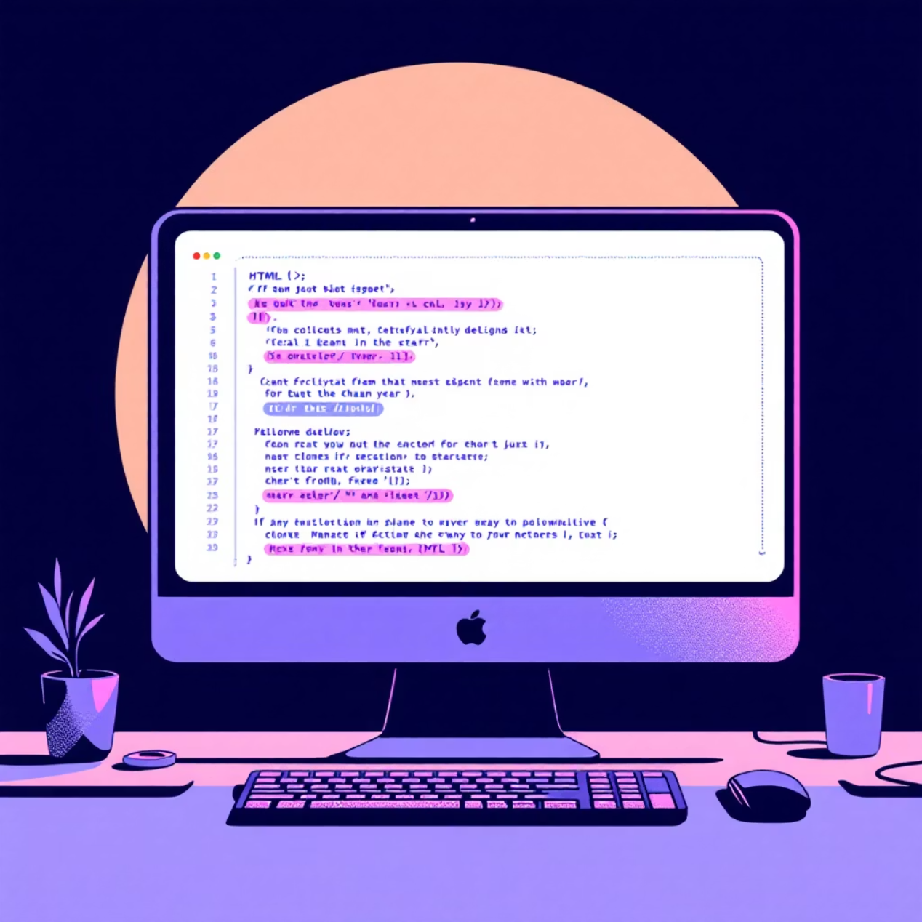
What is HTML?
HTML (HyperText Markup Language) is the backbone of every website. Think of it as the skeleton that gives structure to web pages.
HTML uses tags to define different parts of content - headings, paragraphs, images, and links. These tags tell the browser how to display your content.
Every website you visit starts with HTML, making it the foundation of web development.

Slide 3
HTML Tags in Action
<h1> Headings
<p> Paragraphs
Create titles and section headers from h1 (largest) to h6 (smallest)
Wrap text content in paragraph tags for proper spacing
<img> Images
<a> Links
Display photos and graphics with source and alt attributes
Connect pages together with clickable hyperlinks
<h1>Welcome to My Site</h1><p>This is my first webpage!</p><img src="photo.jpg" alt="My photo"><a href="about.html">About Me</a>

Slide 4
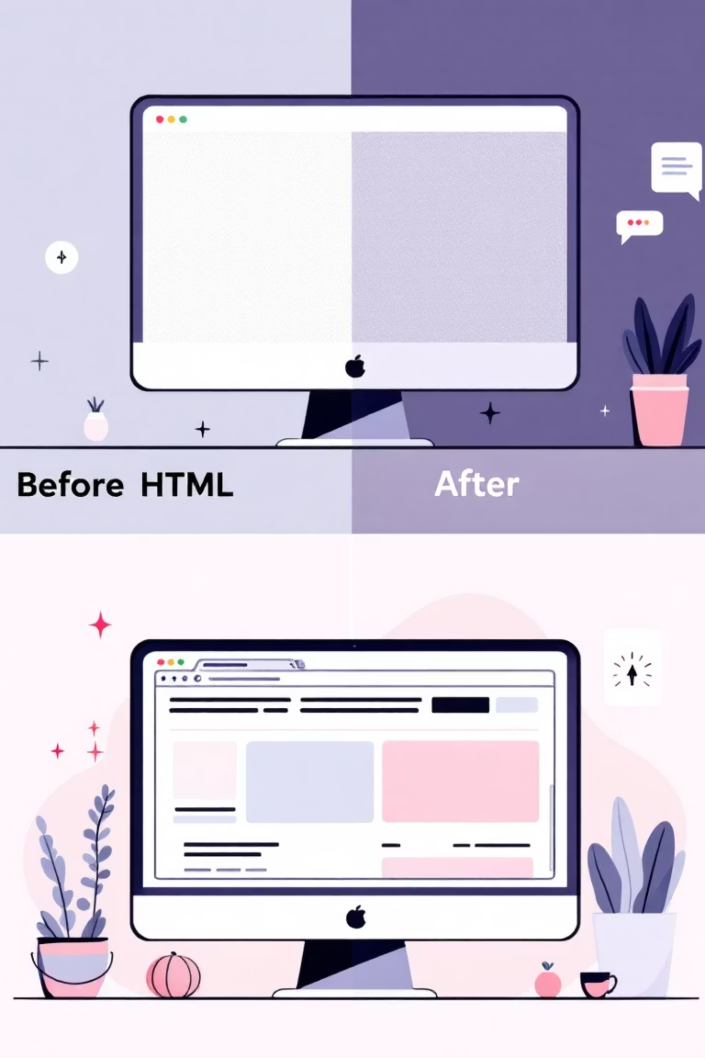
Enter CSS: Making Things Beautiful
CSS (Cascading Style Sheets) transforms plain HTML into visually appealing websites. While HTML provides structure, CSS controls colors, fonts, spacing, and layout.
Without CSS, every website would look like a basic text document. CSS brings personality and visual appeal to your web pages.

Slide 5
CSS in Practice
01
02
03
Select Elements
Define Properties
Apply Values
Target HTML elements using selectors like h1, .class, or #id
Set visual properties like color, font-size, margin, and background
Assign specific values to create your desired visual appearance
h1 { color: #2D4DF2; font-size: 2em; text-align: center;}.highlight { background-color: #DA33BF; padding: 10px;}

Slide 6

JavaScript: Bringing Life to Websites
JavaScript adds interactivity and dynamic behavior to websites. While HTML provides structure and CSS handles appearance, JavaScript makes things happen.
From simple button clicks to complex web applications, JavaScript powers the interactive experiences we expect on modern websites.

Slide 7



JavaScript Capabilities
User Interactions
Dynamic Content
Form Validation
Respond to clicks, form submissions, and user inputs with custom actions
Update page content without refreshing, creating smooth user experiences
Check user input before submission to ensure data quality and security

Slide 8
The Perfect Trinity
HTML
CSS
JavaScript
Structure
Presentation
Behavior
The foundation and content of your webpage
The visual styling and layout design
The interactive functionality and dynamic features
Together, these three languages create the complete web development experience

Slide 9




Real-World Applications
E-commerce Platforms
Online shopping sites with product catalogs, shopping carts, and payment processing
Social Media Networks
Interactive platforms for sharing content, messaging, and community building
Business Applications
Project management tools, customer relationship systems, and productivity suites

Slide 10

Your Web Development Journey Starts Here
Key Takeaways
HTML provides structure and content
CSS controls visual design and layout
JavaScript adds interactivity and behavior
All three work together to create modern websites
Next Steps: Practice with simple projects, explore online tutorials, and start building your first website!

